Slide 1

HOS303A: International Restaurant Concepts
Topic 7

Slide 2
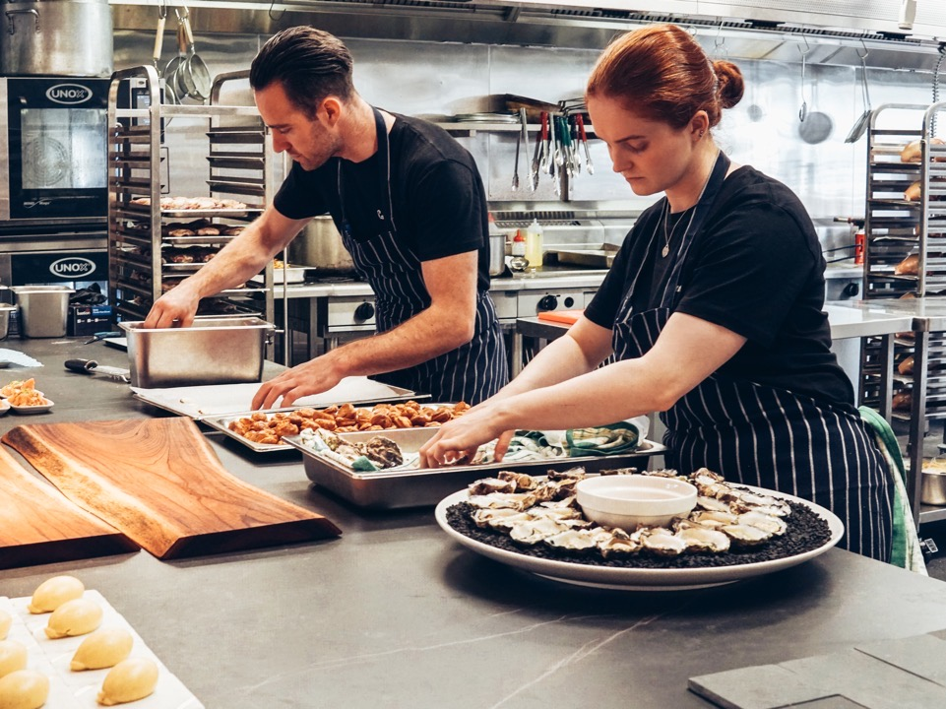
International Restaurant Concepts
Kitchen Layout and Equipment

Slide 3
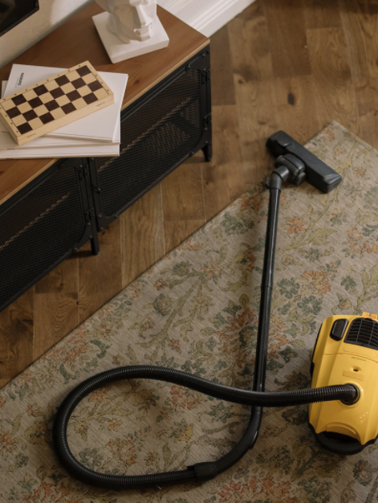
Assessment Housekeeping
First assessment grade and feedback early next week.
Second assessment: Read your case study
Supplementary short videos of discussion with Mourad Mazouz
Use FAQ forum for questions. I will post some popular questions there.
Confirm your working groups for Groups Assessment 3
https://icms.padlet.org/nassima_kennedy1/mgshfgn2k87b7w0m

Slide 4

7.3 Activity
Getting to know Beverly Hills….
This is your opportunity to start researching the characteristics of the Beverly Hills city, Los Angeles area in preparation for your second assessment...
https://icms.padlet.org/nassima_kennedy1/7zx10bxemsm3ychq

Slide 5
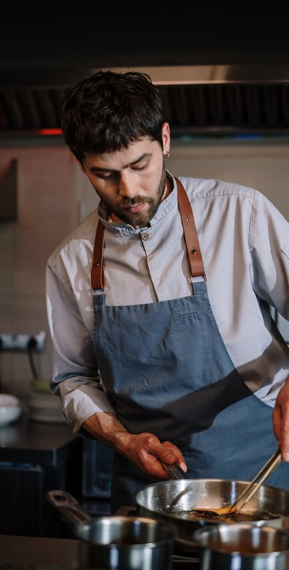
7.1 Activity Review
This week, we will be looking at kitchen design and equipment. Think about your favourite food and share with the group how it's cooked. Fried, grilled, boiled, steamed etc.? Your responses will be compiled to create a word cloud we'll review at the start of class this week.

Slide 6
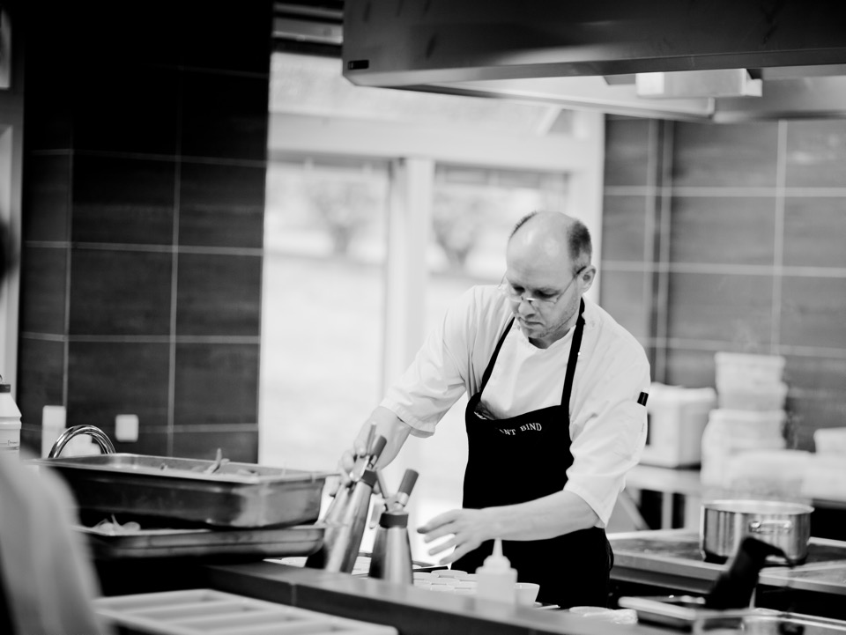
Weekly Content
Factors to consider when planning a kitchen’s layout
Design for Safety and compliance
Cooking techniques and equipment
Closed vs. Open Kitchens

Slide 7
Concept and Market
Quality
Menu
Price
Atmosphere
Location
Management
Food
Service
(Walker, 2014, page 67)

Slide 8
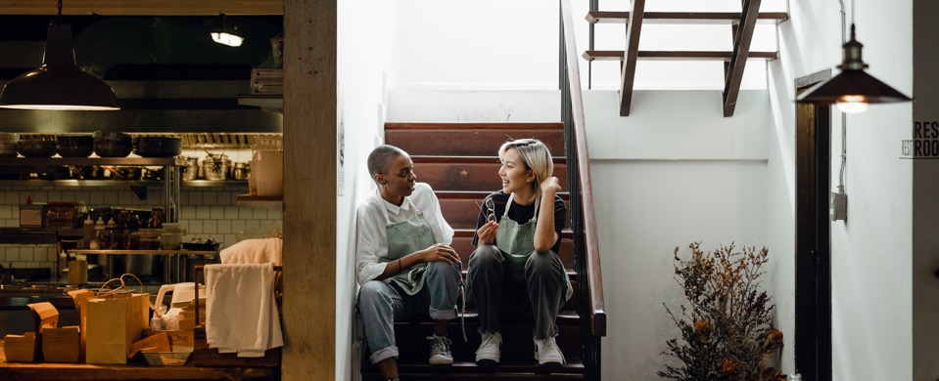
The importance of designing a commercial kitchen
Success as a food business is in the kitchen design.
A strong design will make the kitchen run smoothly and efficiently, so everything must be planned long before the restaurant is open.
A vital part of your operation is the design of your commercial kitchen.
(Designing a Commercial Kitchen, 2017)
Notes:
Content in full here: https://www.nisbets.com.au/designing-commercial-kitchen

Slide 9
The Catering Cycle
Planning the menu and expected covers
Buying
Receiving
Storage
Issuing
Production
Serving
After service/ cleaning
(Adapted from Ford, Hunter, Tinton & Rippington, 2015, page 320)

Slide 10
Kitchen Flow
Goods in (delivery)
Storage: Cold or Ambient
Preparation
Cook
Service
Dishes return from dining room
(Designing a Commercial Kitchen, 2017)

Slide 11

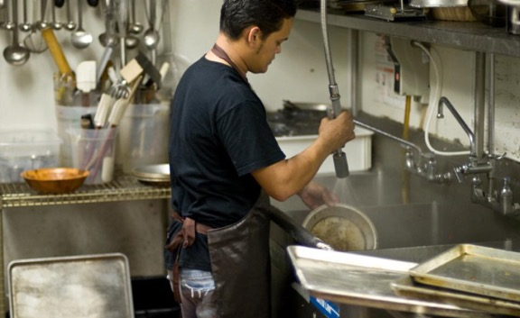
Crockery and Cooking Utensils
Crockery is scraped into bin / recycling
Baskets are loaded with crockery and pre-rinsed using a spray hose
Baskets are then left to air dry on basket runners or placed onto an open rack
Clean crockery is then usually stored in the hot cupboard in the pass area
Prep, Cook and Dishes Return should be separate and never cross over in the flow design
(Designing a Commercial Kitchen, 2017)

Slide 12
Designing a Kitchen
The Golden Triangle Model
Food preparation (such as mixers and slicers)
Cooking and Serving (such as range ovens and bain maries)
Washing up (such as dishwashers or glasswashers)
(The Golden Triangle Kitchen Design , 2017)
Notes:
Full Resource here: https://www.nisbets.com.au/thegoldentriangle

Slide 13
Principles of the
“Golden Triangle”
No major kitchen traffic should flow through the centre of the triangle
Cupboards and other appliances should not intersect any side of the triangle by more than 12 inches
A full height appliance or cupboard should not come between any two focal points of the triangle
(The Golden Triangle Kitchen Design , 2017)

Slide 14
Refinement of the “Golden Triangle”
Storage: Ingredients must be kept fresh and free from contamination and at the right temperature depending on the product. Utensils must be easily accessible.
Food Preparation: Whether you’re chopping onions or poultry, it’s vital to segregate different types of food during prep.
Cooking: The cookline is the heart of the kitchen and the engine. The location of the cooking equipment is vital to a smooth operation.
Service: Efficient kitchen design means front-of-house staff have rapid and safe access to the pass without disrupting the kitchen flow.
Cleaning / Washing: Plates, glasses, cutlery need to be washed ready for re-use. A well-designed wash-up that allows adequate space for sorting and handling in conjunction with the correct dishwasher is vital.
(Designing a Commercial Kitchen, 2017)

Slide 15
Sample Layout
(Designing a Commercial Kitchen, 2017))

Slide 16
Kitchen Design Layout Options
Island Style
Zone Style
Assembly Line Style
(Restaurant Kitchen Layouts, 2018)
Notes:
Read more here: https://www.webstaurantstore.com/article/11/restaurant-kitchen-layouts.html

Slide 17
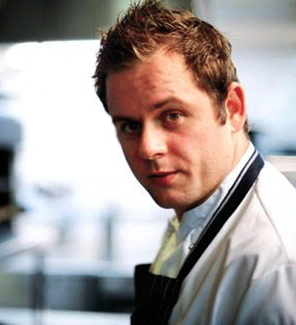
Watch: Pearls of Wisdom
“How kitchen design affects efficiency” with Bryn Evans
Notes:
Watch here or linked on Moodle: https://youtu.be/VqmPd6HMaXs

Slide 18
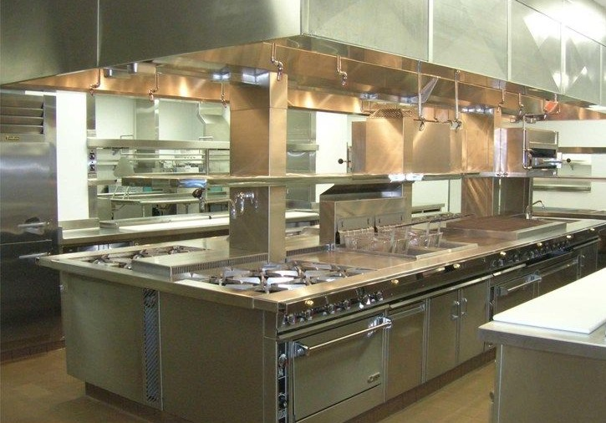
Island Style
An island-style kitchen features one main block in the middle of the main space.
Usually the cooking equipment is in the middle, with food prep, storage and kitchen to FOH transition areas on the outer walls. Sometimes this is reversed

Slide 19
Zone Style
In a zone-style layout the kitchen is divided into different sections.
There are sections for food prep (hot and cold), for cooking, for refrigeration and ice machines.
For sanitation and washing as well as a section for kitchen to FOH transition.

Slide 20
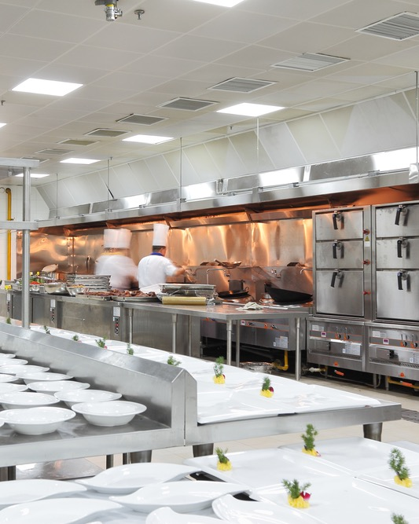
Assembly Line Style
This is ideal for restaurants producing large quantities of the same food, such as pizza places or sandwich shops.
The kitchen is laid out in order of use and equipment is set up in a line, creating a conveyor belt-style operation.
A pizza shop, for example, can start with the refrigerator, moving to the dough-shaping area, to the pizza prep table, then to the gas deck oven, and eventually the warming and holding station or into a pizza box.

Slide 21
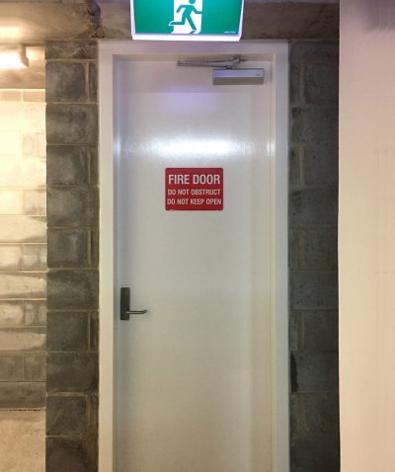
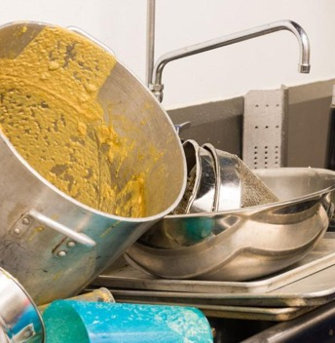
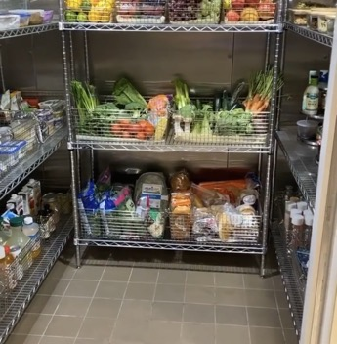
Practicalities
From Previous Week…
Plumbing Requirements
Equipment Elevations
Refrigeration
Storage
Fire Regulations
Exhaust air extraction and intake requirements

Slide 22
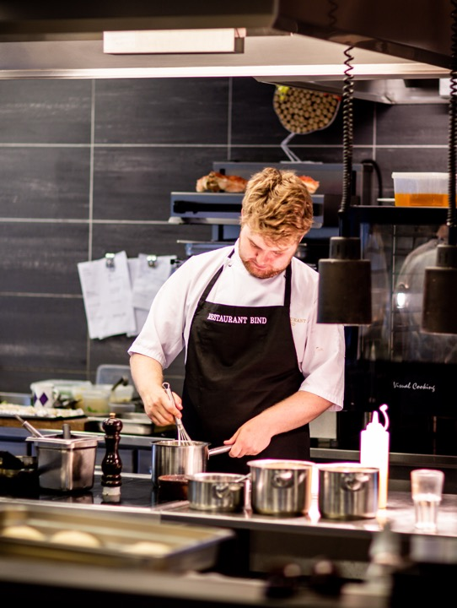
Spatial Planning Questions
How much space do I have available?
What is my intended food offer or menu?
How many people will I be employing to run the kitchen?
What is my style of service?
How many covers am I looking to achieve?
(Designing a Commercial Kitchen, 2017)

Slide 23
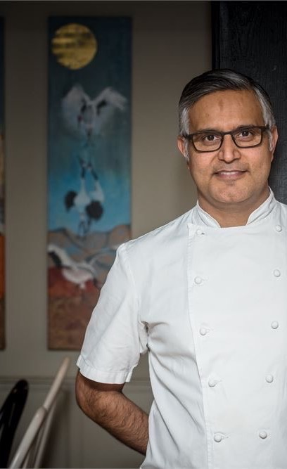
Watch: Pearls of Wisdom
“How I plan kitchens” with Atul Kochhar
In this video, Atul talks through how he approaches kitchen design and selects equipment.
In his most recent restaurant, Kanishka, he had to alter the cooking techniques of some of the dishes as we was unable to use charcoal at the restaurant site.
Notes:
Watch here or linked on Moodle: https://youtu.be/Z9vE0tkQ2Oo
Bonus Pearls of Wisdom with Atul here: The grease trap always overflows on a busy Saturday night: https://www.youtube.com/watch?v=GR4xXhqh4sY&feature=youtu.be

Slide 24

Delivery
Location of goods received should be as near as possible to the delivery point.
Adequate room to allow staff to enter and exit the kitchen without being impeded by trolleys and crates (Health and Safety).
An allowance of racking and table space.
Fresh produce or a mix of fresh, pre-prepared and frozen and how often?
This will determine what equipment is needed as well as have a bearing on storage and prep storage.
(Designing a Commercial Kitchen, 2017)

Slide 25
Storage
Refrigerated Storage: Space permitting, a walk-in cold room is the ideal that most chefs and operators require.
Freezer Storage: Walk in freezer differ from cold stores in the fact that they need an insulated floor to maintain its optimum temperature. Needs a raised floor.
Dry Storage: Houses all the ambient goods that are used –tinned or canned goods, spices or fresh produce.
Non-Food Storage – Non-perishable and disposables: This can be napkins, paper cups, paper plates, till rolls, order books etc.
Crockery Storage: Located in an area that is clean and free from grease, water and dirty items. It’s normally located near to the exit table of the dish-wash area and nowhere near a pre-rinse spray.
COSHH Storage (Control Of Substances Hazardous to Health): A lockable COSHH room/ cabinet.
(Designing a Commercial Kitchen, 2017)

Slide 26
Consider Storage and Functionality
Sliding door storage takes up less space and allow for movement in narrow spaces
Under work bench fridge drawer
Equipment should be strategically placed so that staff can take as few steps as possible, with minimal bending, reaching, walking or turning.
Example: Salamander grill should be near your main oven range. Fridge, freezer and blast chiller should be close together for fast access to refrigeration.
Wall shelves for storage where possible

Slide 27
Design for Energy Efficiency
Creating an energy-efficient kitchen saves money.
Refrigeration and cooking equipment should be kept apart to save your refrigeration unit from overworking.
Cooking equipment should also be strategically placed to promote the ventilation hoods’ efficiency.
TIP: A heated kitchen can also affect equipment.
Equipment such as fridges can lose effectiveness if the atmosphere is too hot.

Slide 28
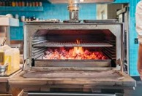
Cooking Equipment
Gas Hob
Induction
Deep Fryer
Sous Vide
Plancha / Griddle
Combi Oven
Wood Fired Oven
Josper Charcoal Oven
Salamander
Microwave
Tandoor

Slide 29

Refer back to that word cloud in Activity 7.1…
What equipment would you need?
How did design affect your experiences in industry training?

Slide 30
Sourcing Equipment:
New, Second Hand or Rented?
New
$18,183.00
Rent to Buy
$157 +GST/WK
Used
$18,183.00
Used
$4,000.00

Slide 31
Design for Compliance
Water Supply
  Handwashing facilities next to toilets
Sewage and waste water disposal
Storage of garbage and recyclable matter
Availability of Power
Ventilation
Safety Lighting
(Australia New Zealand Food Standards Code - Standard 3.2.3 - Food Premises and Equipment, 2000)

Slide 32

Grease Traps
Grease traps are designed to hold wastewater for a period of time to allow oil and grease to separate from the liquid and rise to the top of the grease trap.
Cleaner wastewater underneath the fat layer then flows to the sewer.
The grease traps should be as close to the source of grease as possible, so pipes between the kitchen and the grease trap don’t clog with grease.
If you cook or serve hot food, you must have a grease trap and a trade waste agreement with Sydney Water.
(Plumbing for retail food businesses, 2019)
Notes:
Full resource here: https://www.sydneywater.com.au/web/groups/publicwebcontent/documents/document/zgrf/mdq1/~edisp/dd_045460.pdf

Slide 33
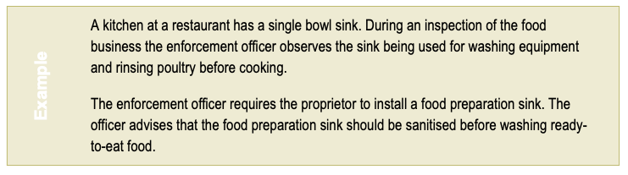
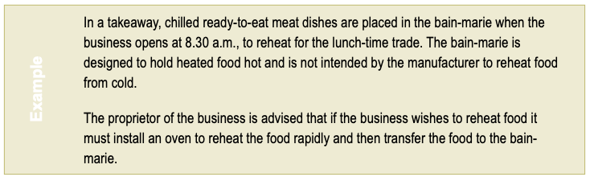
Examples of Compliance Requirements
(Australia New Zealand Food Standards Code - Standard 3.2.3 - Food Premises and Equipment, 2000, page 161)

Slide 34
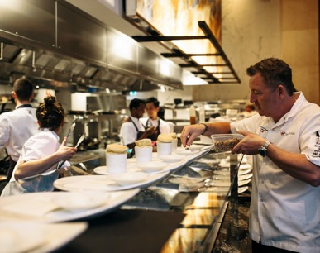
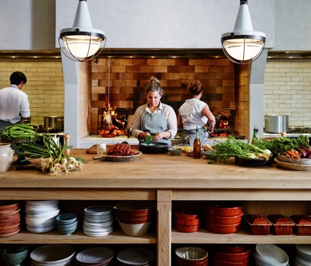
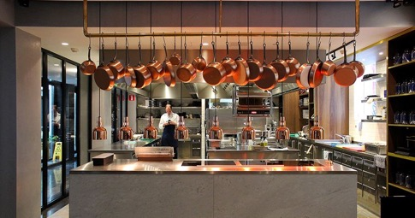
Open Kitchens?
Open Kitchen create a sense of theatre- creating interaction and atmosphere.
Focal Points: A steakhouse focuses on the cooking of meat, an Italian restaurant on pizza
The area set aside for open kitchens costs about 25 percent more than in a standard kitchen
(Walker, 2014, page 147-148)

Slide 35

Activity:
Form your Groups for Assessment 3
A Concept
Create a Mood Board
Brainstorm
Create a list of kitchen equipment you might need for your concept
Consider kitchen space and workflow.
Notes:
Use this supplier to create a shopping list: https://www.nisbets.com.au/designing-commercial-kitchen

Slide 36
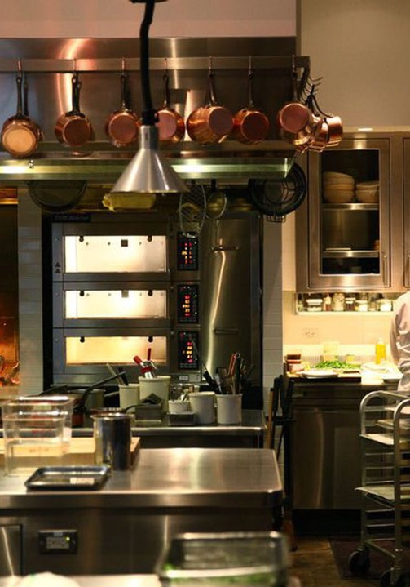
Closing Thoughts
Kitchen planning precedes equipment purchasing.
The kitchen plan helps ensure an easy flow of food in and out of the kitchen. The idea is to place the equipment in such a way that the distance between it and the staff members who use it is minimised.
Planners may recommend equipment that fits the menu and the restaurant’s clientele and make sure that the chef and kitchen crew have the knowledge and skills to operate the kitchen.
(Walker, 2014, page 166)

Slide 37

Sources
Australia New Zealand Food Standards Code - Standard 3.2.3 - Food Premises and Equipment (2000). Retrieved from https://www.foodstandards.gov.au/publications/documents/3_2_3.pdf
Designing a Kitchen (2017, June 27). Nisbets. Retrieved from https://www.nisbets.com.au/designing-commercial-kitchen
Eversham, E. (2014, January 28). Equipping your kitchen: How to work with the space you’ve got. Big Hospitality. Retrieved from https://www.bighospitality.co.uk/Article/2014/01/28/Choosing-equipment-for-a-small-commercial-kitchen
Ford, Hunter, Tinton & Rippington, (2015). Professional chef : commercial cookery volume 2 (2nd edition). Cengage Learning Australia, South Melbourne, Victoria, Australia
Nicholls, N. (2014, January 31). Equipping your kitchen : A buyer’s Guide. Big Hospitality. Retrieved from https://www.bighospitality.co.uk/Article/2014/01/29/Kitchen-Equipment-2014-guide-for-UK-restaurants-chefs
Plumbing for retail food businesses (2019). Sydney Water. Retrieved from https://www.sydneywater.com.au/web/groups/publicwebcontent/documents/document/zgrf/mdq1/~edisp/dd_045460.pdf
Restaurant Kitchen Layouts (2018, June 22). Webstaurant Store. Retrieved from https://www.webstaurantstore.com/article/11/restaurant-kitchen-layouts.html
The Golden Triangle Kitchen Design (2017, May 25). Nisbets. Retrieved from https://www.nisbets.com.au/thegoldentriangle
Walker, J. R. (2017). The restaurant : from concept to operation. [Book] (8th ed.). John Wiley
Walker, J. R. (2014). The restaurant : from concept to operation. [Book] (7th ed.). John Wiley

Slide 38
Thank you
What questions do you have?...
COMMONWEALTH OF AUSTRALIA
Copyright Regulations 1969
WARNING
This material has been reproduced and communicated to you by or on behalf of International College of Management, Sydney pursuant to Part VB of the Copyright Act 1968 (the Act).
The material in this communication may be subject to copyright under the Act. Any further reproduction or communication of this material by you may be the subject of copyright protection under the Act.
Do not remove this notice.

